Slide 1
The Scenario Explorer
Presentation to HPAC on March 20, 2025
Bruce Parker
Notes:
Thank you, Dennis for you introduction and for helping me with the development of the Scenario Explorer.

Slide 2
A “Simple” Request
Notes:
I started working on the Scenario Explorer after a chance meeting with Dennis in an HPAC Zoom meeting room last October. Dennis had come up with a CO2 emissions pathway for an HPAC strategy document and had what seemed like a very simple need

Slide 3
A “Simple” Request
Are there simple computer tools that can be used to estimate the amount of solar radiation management that would be needed to limit the temperature increase to 1.5°C in 2100 for the HPAC CO2 emissions pathway?
Notes:
He wanted to know if there were there any simple computer tools that could be used to estimate the amount of solar radiation management that would be needed to limit the temperature increase to 1.5°C in 2100 for the HPAC CO2 emissions pathway?

Slide 4
A “Simple” Request
Are there simple computer tools that can be used to estimate the amount of solar radiation management that would be needed to limit the temperature increase to 1.5°C in 2100 for his CO2 emissions pathway?
No!
Notes:
Unfortunately none seem to exist. And given the expected dire consequences from the expected global warming, it’s very unfortunate that this is the case.

Slide 5
What I’ll cover this evening
How Temperature Forecast Model Works
Projections, Scenarios, and Pathways
On-line demo
“What if”
How you can help
Notes:
After providing a little background information, I’ll lead you through the model’s calculations and then briefly Projections, Scenarios, and Pathways, since these are what the model works with. Next will be an on-line demonstration of the Scenario Explorer web page followed by discussing one important way the Scenario Explorer can be used - to conduct “What If” analyses. And finally I’ll ask for help in looking for ways improve the web site to further HPAC’s mission.
I’m going to cover a lot of information quickly. We can come back later for further discussions and you can also download this presentation.

Slide 6
A “Simple” Challenge
Develop a Web-based program that allows a user to
Design a CO2 emissions pathway
Specify the amount of the solar radiation modification for a specific set of years and then have the program calculate the expected temperature change
Notes:
I have been developing web-based database applications for over 20 years and have been analyzing climate data for at least as long. So developing a simple model that could be used as Dennis requested seemed like a great challenge.

Slide 7
Prelude to Developing the Web Page
Examine the current radiative forcing elements
Notes:
The temperature increase in a particular year is primarily based on the total radiative forcing, so in order to work, the model will need to know the radiative forcing of the greenhouse gases other than CO2.
So I looked at the current radiative forcing values to gain some insights

Slide 8
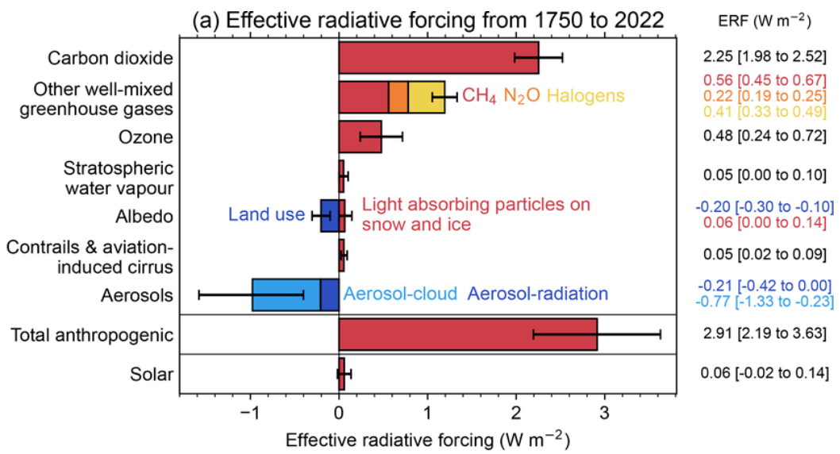
Radiative Forcing
The radiative forcing for any “forcing element” is basically the amount of the Sun’s energy that it traps in (or reflects out of) in the Earth’s atmosphere.
DOI:10.5194/essd-15-2295-2023
Notes:
This is a standard diagram of the major radiative forcing elements. Note that CO2, CH4, and N2O make up almost 90% of the forcing due to the dozens of greenhouse gases.

Slide 9
Radiative Forcing
“Other Radiative Forcing” = Total RF – (CO2 RF + CH4 RF + N2O RF + Aerosol RF)
DOI:10.5194/essd-15-2295-2023
Notes:
The data for the scenarios that I used to create the formulas for the model generally did not include many of the forcing elements shown in the diagram (these are circled) but did include a value for the total radiative forcing. And to help simplify the model’s calculations I subtracted radiative forcings of CO2, CH4, N2O, and aerosols from the total radiative forcing to get a value for “Other Radiative Forcing” and used those five forcing elements plus albedo in the calculations.

Slide 10
Prelude to Developing the Web Page
Examine the current radiative forcing elements
Look at data from existing climate models to see if there is a way to develop a series of formulas that could be used to get from “CO2 emissions” to a “reasonably accurate temperature increase”.
Notes:
I next analyzed the data from existing climate models to see if there was a way to develop a series of formulas that could be used to get from “CO2 emissions” to a “reasonably accurate temperature increase”. And I think that I’ve come up with some reasonably good correlations.

Slide 11
Prelude to Developing the Web Page
Examine the current radiative forcing elements
Look at data from existing climate models to see if there is a way to develop a series of formulas that could be used to get from “CO2 emissions” to a “reasonably accurate temperature increase”.
Develop a model that works in three steps:
1. Calculate the radiative forcing of CO2 based on annual CO2emissions
2. Add up the radiative forcing from all of the forcing elements.
3. Calculate the temperature increase based on the total radiative forcing.
Notes:
I then developed a “temperature calculation model” with three major steps which I will cover in the next few slides.
I’m still looking for someone to validate my approach, but the model seems to be useful, as it is based on data from well known climate models. In the meantime, please experiment with the web page’s functions, but don’t assume that the results are 100% accurate.

Slide 12
Simple Temperature Forecast Model
The model uses these forcing elements to calculate the expected temperature increase.
# | Forcing Element | Notes | Units | 2050 | 2100
1 | CO2 | Emissions and removals (including feedbacks) Need to first calculate the amount of CO2 that is added/removed from the atmosphere to get the change in atmospheric concentration | W/m-2 | 3.21 | 3.29
2 | CH4 | Can be computed from atmospheric concentration | W/m-2 | 0.61 | 0.59
3 | N20 | Can be computed from atmospheric concentration | W/m-2 | 0.28 | 0.38
4 | Aerosols |  | W/m-2 | -0.70 | -0.50
5 | All other forcing elements | Total RF – (CO2 RF + CH4 RF + N2O RF + Aerosol RF) | W/m-2 | 1.05 | 0.86
6 | Albedo | Some included in the AR6 temperature calculations | W/m-2 | 0.00 | 0.00
Notes:
As I mentioned before, the model uses values for these six forcing elements to calculate the expected temperature increase. Note that the radiative forcing for CO2 cannot be calculated directly from a pathway’s CO2 emissions. And for a “CO2 emissions only” pathway, the model needs a way to infer the radiative forcings of the non-CO2 forcing elements

Slide 13
Simple Temperature Forecast Model
Step 1. Calculate the radiative forcing of CO2 based on annual CO2emissions. This is done in six stages
Stage 1. Estimate emissions from feedbacks
# | CO2 Sources and Removals | Calculation | Units | 2050 | 2100
7 | Anthropogenic CO2 emissions |  | GTCO2 | 30.00 | 5.00
8 | Carbon Removal at the Source |  | GtCO2 | 0.00 | 0.00
9 | Carbon Removal from Atmosphere |  | GtCO2 | 0.00 | 0.00
10 | Feedbacks | Formula if no data | GtCO2e | 9.00 | 17.00
Not all scenarios include emissions from natural feedbacks. And feedbacks are generally not specified for a simple “CO2 only” pathway. In this case the model assumes that the feedback emissions in 2100 will be based on the expected temperature in 2100. More on this later if there is time.
Notes:
I’ll now quickly describe the calculations, as this will help you when you use the Scenario Explorer. There are four primary sources and sinks of CO2. For a simple CO2 pathway we can assume that there are not any removals. For feedbacks, the IPCC assumes that the feedback emissions in 2100 can be based the temperature in 2100, and this model makes the same assumption.

Slide 14
Simple Temperature Forecast Model
Stage 2 of 6. Calculate the Total Net CO2
# | CO2 Element | Calculation | Units | 2050 | 2100
7 | Anthropogenic CO2 emissions |  | GTCO2 | 30.00 | 5.00
8 | Carbon Removal at the Source |  | GtCO2 | 0.00 | 0.00
9 | Carbon Removal from Atmosphere |  | GtCO2 | 0.00 | 0.00
10 | Feedbacks | Formula if no data | GtCO2e | 9.00 | 17.00
11 | Total Net CO2 | Sum | GtCO2 | 39.00 | 22.00
Notes:
Now that we have values for feedback emissions, we can compute the total net CO2 emissions for each time period as the sum of the sources and removals. Note that this model looks at annual emissions in five-year intervals

Slide 15
Simple Temperature Forecast Model
Stage 3 of 6. Calculate the cumulative net CO2
# | CO2 Element | Calculation | Units | 2050 | 2100
7 | Anthropogenic CO2 emissions |  | GTCO2 | 30.00 | 5.00
8 | Carbon Removal at the Source |  | GtCO2 | 0.00 | 0.00
9 | Carbon Removal from Atmosphere |  | GtCO2 | 0.00 | 0.00
10 | Feedbacks | Formula if no data | GtCO2e | 9.00 | 17.00
11 | Total Net CO2 | Sum | GtCO2 | 39.00 | 22.00
12 | Cumulative CO2 | Sum | GtCO2 | 1215.00 | 2482.00
The cumulative CO2 is used in a future step.
Notes:
Given the Total Net CO2, the cumulative CO2 can easily be calculated

Slide 16
Simple Temperature Forecast Model
Stage 4 of 6. Estimate how the atmospheric quantity of CO2 will change based on net CO2 emissions
# | CO2 Element | Calculation | Units | 2050 | 2100
7 | Anthropogenic CO2 emissions |  | GTCO2 | 30.00 | 5.00
8 | Carbon Removal at the Source |  | GtCO2 | 0.00 | 0.00
9 | Carbon Removal from Atmosphere |  | GtCO2 | 0.00 | 0.00
10 | Feedbacks | Formula if no data | GtCO2e | 9.00 | 17.00
11 | Total Net CO2 | Sum | GtCO2 | 39.00 | 22.00
12 | Cumulative CO2 | Sum | GtCO2 | 1215.00 | 2482.00
13 | CO2 PPM Change/Year | Formula | PPM | 1.85 | -0.03
Notes:
The next step is to estimate how the atmospheric quantity of CO2 will change based on net CO2 emissions. Currently about 45 percent of CO2 emissions remain in the atmosphere (often referred to as the airborne fraction), but the percent will be less when CO2 emissions are reduced significantly.

Slide 17
Simple Temperature Forecast Model
Stage 4 of 6 (con’t). Estimate how the atmospheric quantity of CO2 will change based on net CO2 emissions
The graph below relates the change in the amount of CO2 added to the atmosphere based on net CO2 emissions
If the “Total Net CO2” >=0
CO2 PPM Added = 0.009993255 * NetCO2² + 0.252616086 * NetCO2- 10.6147928 + 4 * (yr - 2025) / 75 + 0.6
(Based on data from the En-ROADs climate simulator)
Notes:
This graph relates the change in the amount of CO2 added to the atmosphere based on net CO2 emissions. I developed the formula from data obtained from the En-ROADs climate simulator. Note that CO2 will be removed from the atmosphere by the land and ocean sinks when annual CO2 emissions are in the 10-20 gigaton range

Slide 18
Simple Temperature Forecast Model
Stage 4 of 6 (con’t). Estimate how the atmospheric quantity of CO2 will change based on net CO2 emissions
The formula works very well for En-ROADS “Temperature Increase Scenarios” where the temperature increases between 1.6°C and 2.8°C in 2100. The difference in the 2100 PPM in those scenarios is at most 8 PPM (and usually within 4-5 PPM).
Notes:
For most of the formulas that I derive I like to create some sort of graph that shows how well the formula works. In this case I took eight En-ROADs scenarios and calculated the CO2 concentrations from 2025 through 2100 and compared them to the CO2 concentrations from each scenario. As shown in the graph, for the scenarios with less than a 3 degree temperature increase, the calculated value for 2100 was usually with in 4-5 PPM of the scenario’s value. This means that the formula works very well.

Slide 19
Simple Temperature Forecast Model
The first step in forecasting the temperature increase is to calculate the radiative forcing of CO2. This is done in five stages
Stage 5 of 6. Calculate the CO2 PPM
# | CO2 Element | Calculation | Units | 2050 | 2100
7 | Anthropogenic CO2 emissions |  | GTCO2 | 30.00 | 5.00
8 | Carbon Removal at the Source |  | GtCO2 | 0.00 | 0.00
9 | Carbon Removal from Atmosphere |  | GtCO2 | 0.00 | 0.00
10 | Feedbacks | Formula if no data | GtCO2e | 9.00 | 17.00
11 | Total Net CO2 | Sum | GtCO2 | 39.00 | 22.00
12 | Cumulative CO2 | Sum | GtCO2 | 1215.00 | 2482.00
13 | CO2 PPM Change/Year | Formula | PPM | 1.85 | -0.03
14 | CO2 PPM | Add | PPM | 497.00 | 504.00
Notes:
Now that we know the expected change in the atmospheric concentration of CO2, we simply add that value to the previous years concentration value to get the concentration value for the current year.

Slide 20
Simple Temperature Forecast Model
Stage 6 of 6. Calculate the CO2 Radiative Forcing
# | CO2 Element | Calculation | Units | 2050 | 2100
7 | Anthropogenic CO2 emissions |  | GTCO2 | 30.00 | 5.00
8 | Carbon Removal at the Source |  | GtCO2 | 0.00 | 0.00
9 | Carbon Removal from Atmosphere |  | GtCO2 | 0.00 | 0.00
10 | Feedbacks | Formula if no data | GtCO2e | 9.00 | 17.00
11 | Total Net CO2 | Sum | GtCO2 | 39.00 | 22.00
12 | Cumulative CO2 | Sum | GtCO2 | 1215.00 | 2482.00
13 | CO2 PPM Added/Year | Formula | PPM | 1.85 | -0.03
14 | CO2 PPM | Add | PPM | 497.00 | 504.00
15 | CO2 Radiative Forcing | Formula | W/m-2 | 3.21 | 3.29
Notes:
And given the CO2 concentration we can compute the value for CO2’s radiative forcing using a formula derived from IPCC data

Slide 21
Simple Temperature Forecast Model
Stage 6 of 6 (con’t). The calculated CO2 Radiative Forcing based on CO2 PPM
CO2 Radiative Forcing = -7.2875E-06 * CO2PPM² + 0.018987517 * CO2PPM - 4.390914936
(Based on IPCC AR6 data)
Notes:
This graph shows calculated CO2 Radiative Forcing based on the CO2 concentration

Slide 22
Simple Temperature Forecast Model
Stage 6 of 6 (con’t). The calculated CO2 Radiative Forcing is generally within 1.0% of the original AR6 value
Notes:
As validation of the formula, this graph shows the percentage variance between the calculated CO2 radiative forcing amount and the AR6 radiative forcing amount for over 1400 calculations. The calculated CO2 Radiative Forcing is generally within 1.0% of the original AR6 value. This means that the formula works very well.

Slide 23
Simple Temperature Forecast Model
Step 2. Add up the radiative forcing from all of the major forcing elements.
# | Forcing Element | Calculation | Units | 2050 | 2100
15 | CO2 Radiative Forcing | From the first step | W/m-2 | 3.21 | 3.29
16 | CH4 | Calculation if a “CO2 Only” pathway | W/m-2 | 0.61 | 0.59
17 | N2O | Calculation if a “CO2 Only” pathway | W/m-2 | 0.28 | 0.38
18 | Aerosol | Calculation if a “CO2 Only” pathway | W/m-2 | -0.70 | -0.50
19 | Other Radiative Forcing | Calculation if a “CO2 Only” pathway | W/m-2 | 1.05 | 0.86
20 | Albedo | The user can specify | W/m-2 | 0.00 | 0.00
21 | Total Radiative Forcing | Sum | W/m-2 | 4.41 | 4.62
If the emissions pathway being analyzed does not include the radiative forcing values for CH4,N2O, aerosols, or “other radiative forcing”, the model calculates an appropriate value based on the pathways CO2 radiative forcing value.
Notes:
Next we need radiative forcing values for the other five major forcing elements. Most scenarios include data for four of these, where the “Other Radiative Forcing” is set to the total radiative forcing minus the radiative forcing of CO2, CH4, N2O, and Aerosols. For a “CO2 only” emissions pathway, the model calculates an appropriate value based on the pathways CO2 radiative forcing value.

Slide 24
Simple Temperature Forecast Model
Step 2 – Estimate the radiative forcing values when not known.
If non-CO2 radiative forcing values need to be calculated, the Scenario Explorer first calculates how close the CO2 radiative forcing value is to those of the SSP-1.19 and SSP5-Baseline scenarios.
That “closeness” is then used to determine the various non-CO2 radiative forcing pathways for the scenario.
Notes:
If non-CO2 radiative forcing values need to be calculated, the Scenario Explorer first calculates how close the pathway’s CO2 radiative forcing value is to those of the SSP-1.19 and SSP5-Baseline scenarios, whose values are show in the graph. That “closeness” is then used to determine the various non-CO2 radiative forcing pathways for the scenario.

Slide 25
Simple Temperature Forecast Model
Step 2 – Estimate the radiative forcing values when not known.
If non-CO2 radiative forcing values need to be calculated, the Scenario Explorer first calculates how close the CO2 radiative forcing value is to those of the SSP-1.19 and SSP5-Baseline scenarios.
That “closeness” is then used to determine the various non-CO2 radiative forcing pathways for the scenario.
For example, if a pathway’s CO2 radiative forcing was 5.7 W/m-2 (halfway between the of SSP-1.19 and SSP5-Baseline values), the CH4 radiative forcing would also be halfway between the of SSP-1.19 and SSP5-Baseline values for CH4 or about 0.60 W/m-2 per year.
Note that this is the “default” value and can be adjusted by the user.
Notes:
For example, if a pathway’s CO2 radiative forcing was 5.7 W/m-2 (halfway between the of SSP-1.19 and SSP5-Baseline values), the CH4 radiative forcing would be inferred to be halfway between the SSP-1.19 and SSP5-Baseline values for CH4 or about 0.60 W/m-2 per year. Note that this is the “default” value and can be adjusted by the user.

Slide 26
Simple Temperature Forecast Model
The final step is to calculate the temperature increase based on the total radiative forcing.
# | Forcing Element | Calculation | Units | 2050 | 2100
21 | Total Radiative Forcing | From Step 2 | W/m-2 | 4.41 | 4.62
22 | Climate Factor - “CF” (Ratio “Temp Increase”/”Total RF”) | Formula | W/m-2 | 0.48 | 0.57
Formula:
If the scenario includes a temperature increase the climate factor is calculated from the scenario’s data. If it does not include a temperature the CF for 2025 is set to 0.49, the CF for 2100 is calculated based on a formula, and the CF for the other years is interpolated.
(The term “Climate Factor” is something that I have originated. It is simply the ratio of the temperature increase to the total radiative forcing for a specific year. Because it was derived from IPCC AR6 data for a 67% chance of not exceeding the temperature increase in 2100, it incorporates the climate sensitivity that was used by the various climate models. It also results in the temperature increasing by 0.26°C per decade for the next few decades.)
Notes:
Now that we have a value for the total radiative forcing, we can calculate a value for what I refer to as the climate factor. The term “Climate Factor” is something that I have originated. It is simply the ratio of the temperature increase to the total radiative forcing for a specific year. Because it was derived from IPCC AR6 data for a 67% chance of not exceeding the temperature increase in 2100, it incorporates the climate sensitivity that was used by the various climate models. It also results in the temperature increasing by 0.26°C per decade for the next few decades. If the scenario includes temperature increase values, the climate factor is calculated from the scenario’s data. If a pathway does not include a temperature, the Climate Factor for 2025 is set to 0.49, the climate factor for 2100 is calculated based on a formula, and the Climate Factor for the other years is interpolated.

Slide 27
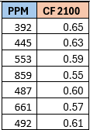
Simple Temperature Forecast Model
The graph at the right shows that the Climate Factor increases fairly linearly from 2025 through 2100 for eight SSP scenarios.
The Climate Factor for 2100 for scenarios without data for a temperature increase specified is calculated as
5.06574E-07 * CO2PPM2100² - 0.000831024 * CO2PPM2100 + 0.895847731
and the CF for the other years is interpolated.
Notes:
As you can see from the graph, the Climate Factor for eight SSPs increases fairly linearly from 2025 through 2100. A polynomial function for estimating the Climate Factor in 2100 was derived based on the CO2 PPM and computed climate factor for seven of the scenarios, as shown in the slide. I don’t have a graph that shows how well the formula works because the formula is not used for the IPCC AR6 and SSP scenarios.
Skip: And since the En-ROADs scenarios do not include a value for the total radiative forcing, the model calculates their climate factors using the above formula.

Slide 28
Simple Temperature Forecast Model
The final step is to calculate the temperature increase based on the total radiative forcing.
# | Forcing Element | Calculation | Units | 2050 | 2100
21 | Total Radiative Forcing | From Step 2 | W/m-2 | 4.41 | 4.62
22 | Climate Factor - “CF” (Ratio “Temp Increase”/”Total RF”) | Formula | W/m-2 | 0.48 | 0.57
23 | Temperature Increase | Calculation: Clim. Factor * Total RF | W/m-2 | 2.15 | 2.63
Notes:
The Temperature Increase can now be set to the Climate Factor * Total Radiative Forcing. And that is how the model works!

Slide 29
Simple Temperature Forecast Model
The following two graphs show the relationship between radiative forcing and temperature for various CO2 concentrations
Notes:
I’m not going to discuss these graphs in detail, but I thought that you might find them useful.

Slide 30
Simple Temperature Forecast Model
The following two graphs show the relationship between radiative forcing and temperature for various CO2 concentrations
Notes:
For instance, if the CO2 PPM is 450 and the year is 2045, 1 w/m-2 of albedo enhancement will reduce the Earth’s temperature by half a degree Celsius.

Slide 31
Projections, Scenarios, and Pathways
“Prediction is very difficult, especially if it's about the future!” Neils Bohr
Climate scientists use complex computer models to forecast possible future temperature increases based on assumptions about governmental climate policies, population and GDP growth, energy prices, etc. Since the temperature increase is due primarily to a change in radiative forcing, the output of all the model runs can include emission pathways for the various greenhouse gases, aerosols, etc.
The Scenario Explorer allows users to both explore these emissions pathways and to develop additional pathways.
Notes:
I thought some additional background might be useful before staring the demo. Climate scientists use complex computer models to forecast possible future temperature increases based on assumptions about governmental climate policies, population growth, GDP growth, energy prices, and so forth. Since the temperature increase is due primarily to a change in radiative forcing, the output of all the model runs usually include emission pathways for the various greenhouse gases, aerosols, etc.
The Scenario Explorer allows users to both explore these emissions pathways and to develop additional pathways.

Slide 32
Projections, Scenarios, and Pathways
Projections
Based on current and expected governmental policies and commitments (e.g., NDCs)
Often allow for variation is some components (e.g., energy prices)
Short term (e.g., through 2050)
Notes:
Projections
Are Based on current and expected governmental policies and commitments (for example., NDCs)
They Often allow for variation is some components (e.g., energy prices)
Are generally only Short term (for example., through 2050)
Because they are based on current and expected governmental policies and commitments, they can be used to constrain what we should plan for

Slide 33
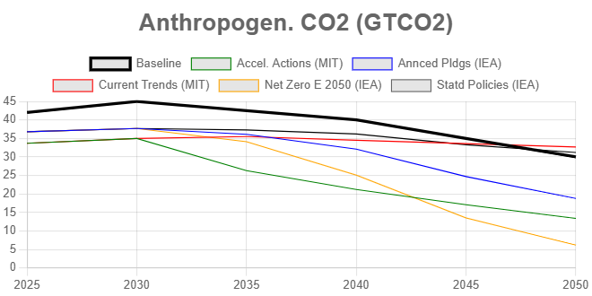
Projections, Scenarios, and Pathways
Projections
Based on current and expected governmental policies and commitments (e.g., NDCs)
Often allow for variation is some components (e.g., energy prices)
Short term (e.g., through 2050)
Notes:
For example, this graph shows the CO2 emissions for HPACs CO2 pathway (in black) along with projections through 2050 by IEA (stated policies) and MIT (Current trends). Obviously both the EIA and MIT scenarios only include some CO2 emissions, perhaps just those from the burning of fossil fuels. Note that both the IEA stated policies scenario and the MIT current trends scenario have CO2 emissions almost unchanged from 2025 through 2050. In addition, the HPACs CO2 pathway is pretty close to the IEA Announced Pledges scenario. And give recent events, even the HPACs CO2 pathway might be optimistic!

Slide 34
Projections, Scenarios, and Pathways
Scenarios
Often have a goal (e.g., 1.5°C in 2100)
Useful for determining what needs to be done to accomplish the various goals
Often not realistic in terms of what is politically possible (e.g., net-zero in 2050)
Examples include:
Representative Concentration Pathways (RCP’s from earlier IPCC reports)
Shared Socioeconomic Pathways (SSPs) (replaces the RCPs)
Shared Socioeconomic Pathways (SSPs) are climate change scenarios that project how global society, economics, and demographics could change by 2100. They are used to analyze how these changes could affect both the climate and greenhouse gas emissions.
Notes:
Scenarios Often have a goal (e.g., 1.5°C in 2100)
They are Useful for determining what needs to be done to accomplish the various goals
They are often not realistic in terms of what is politically possible (e.g., net-zero in 2050)
Examples of scenarios that you are probably familiar with:
Representative Concentration Pathways (RCP’s from earlier IPCC reports)
Shared Socioeconomic Pathways (SSPs) (replaces the RCPs)
Shared Socioeconomic Pathways (SSPs) are climate change scenarios that project how global society, economics, and demographics could change by 2100. They are used to analyze how these changes could affect both the climate and greenhouse gas emissions.

Slide 35
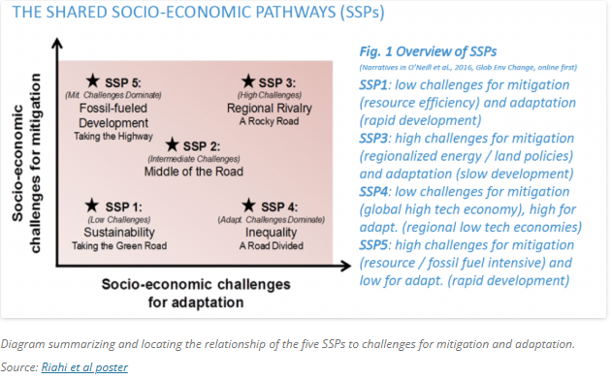
Notes:
This image indicates some of the factors that went into developing the SSP scenarios and you can see from it the breadth of what was analyzed. Note that the AR6 data includes information on about 50 different SSP pathways.. We don’t have time to discuss this today but the “About Scenarios” menu option on the web page will eventually have additional information.

Slide 36
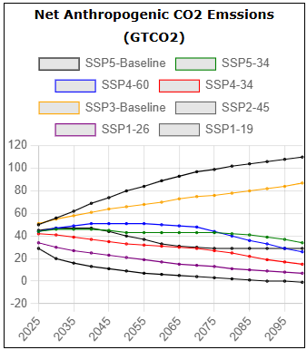
Projections, Scenarios, and Pathways
Scenarios – Sample Data
Notes:
Next I want to show some of the data from eight of the SSP scenarios. This graphs shows the net anthropogenic emissions, which run the gamut from no net CO2 emissions after 2080 to over 100 GTCO2 in 2100

Slide 37
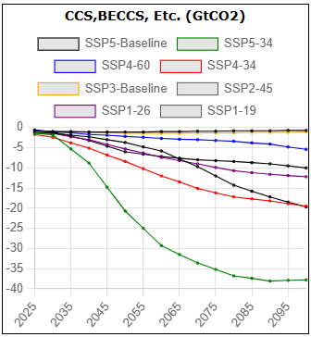
Projections, Scenarios, and Pathways
Scenarios – Sample Data
Notes:
This graphs shows the heavy reliance of the SSP scenarios on carbon removal techniques, which might not work as needed at scale.

Slide 38
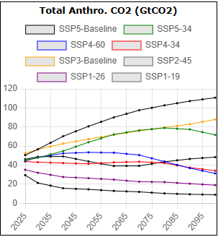
Projections, Scenarios, and Pathways
Scenarios – Sample Data
Notes:
And without carbon removal, many of the pathways have gross CO2 emissions essentially unchanged or increasing through at least 2080.

Slide 39
Projections, Scenarios, and Pathways
Pathways (for greenhouse gas emissions)
All projections and scenarios result in greenhouse gas emission pathways
But a pathway could simply be for CO2 emissions, where the temperature increase can only be forecast by estimating emissions for other greenhouse gases (e.g., HPAC CO2 pathway)
Notes:
All projections and scenarios result in greenhouse gas emission pathways
But a pathway could simply be for CO2 emissions, where the temperature increase can only be forecast by estimating emissions for other greenhouse gases (e.g., HPAC CO2 pathway)

Slide 40
Scenario Explorer Web Site
Once the “temperature increase model” was completed it could be incorporated in the Scenario Explorer Web page and used to satisfy Dennis’s need: estimating the amount of solar radiation management that would be needed to limit the temperature increase to 1.5°C in 2100 for the HPAC CO2 emissions pathway.
Menu Option | Description
About Scenarios | Provides background information on projections, scenarios, and pathways
Consequences | Describes some of the consequences of exceeding a 1.5°C temperature increase
Notes:
Once the “temperature increase model” was completed it could be incorporated in the Scenario Explorer Web page and used to satisfy Dennis’s need: estimating the amount of solar radiation management that would be needed to limit the temperature increase to 1.5°C in 2100 for the HPAC CO2 emissions pathway. The website contains too many options to cover today, but I’d like mention two of them before I start the demo:
About Scenarios - Provides background information on projections, scenarios, and pathways
Consequences - Describes some of the consequences of exceeding a 1.5°C temperature increase
Both need additional information

Slide 41
ON-LINE DEMO

Slide 42
Screen shots from the demo are included in the PowerPoint slides

Slide 43
“What If” analysis
One of the main reasons for developing this model is that, while global circulation models have done a relatively good job in predicting past temperatures changes, the climate system is beginning to behave in unpredictable ways and these models likely underestimate the future yearly temperature increases. (See "Are general circulation models obsolete?“ https://www.pnas.org/doi/10.1073/pnas.2202075119).
For example:
The rate of temperature increase per decade will likely increase (in the IPCC data the rate is 0.26°C but Dr James Hansen expects it to be 0.36°C)
Permanent temperature acceleration in 2023
Accelerated natural emissions (permafrost, wildfires, etc.)
Natural CH4 emissions increasing faster than expected
Albedo changes (clouds and surface reflectivity)
The land and ocean sinks are decreasing faster than expected
Notes:
One of the main reasons for developing this model is that, while global circulation models have done a relatively good job in predicting past temperatures changes, the climate system is beginning to behave in unpredictable ways and these models likely underestimate the future yearly temperature increases.

Slide 44
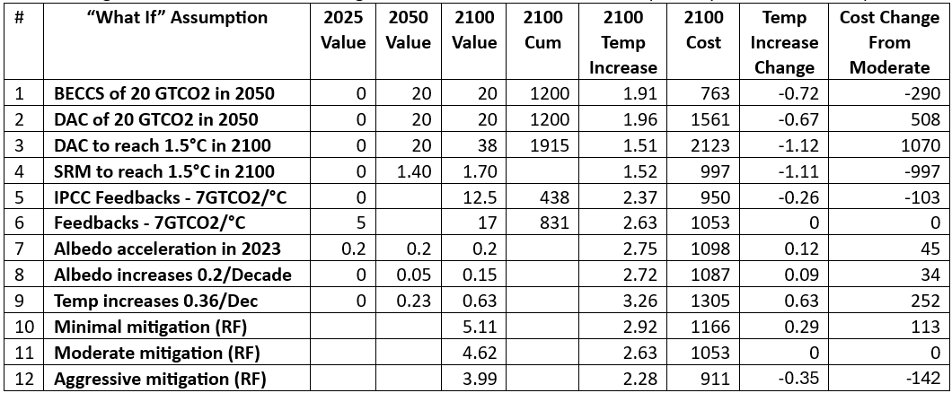
“What If” Analysis for the Moderate Pathway.
Notes:
This is an example of using the Moderate pathway to examine what happens when some of the assumptions change. For instance, if the temperature increases the rate that Dr Hansen expects, the temperature increase in 2100 be an additional 0.63 degrees C.

Slide 45
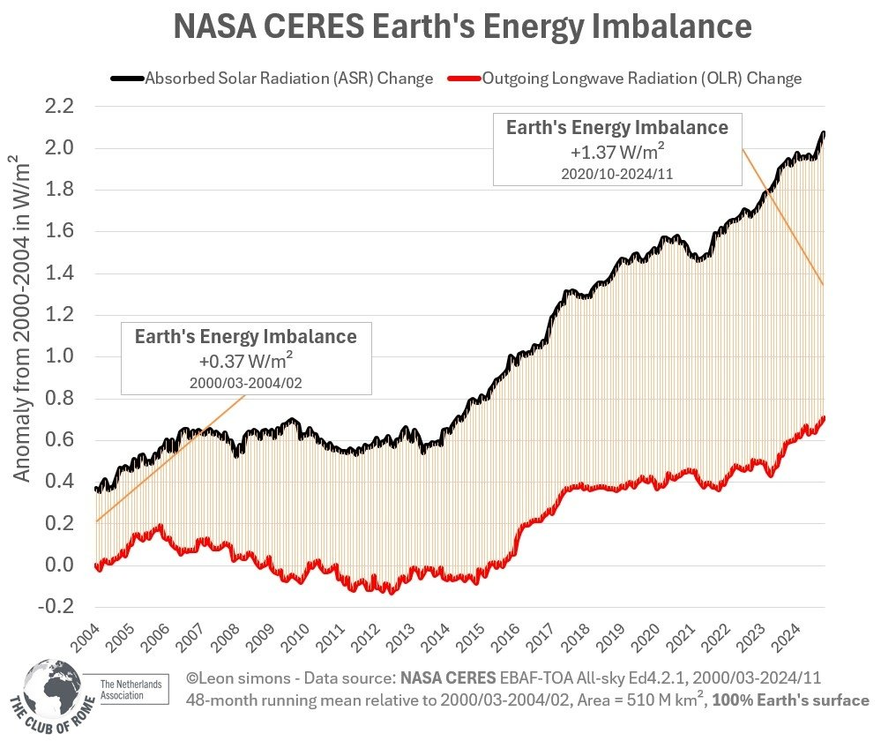
Earth’s Energy Imbalance
The earth’s energy imbalance is now +1.37 W/m2, compared to +0.37 W/m2 at the beginning of the century, and that it is increasing rapidly. This heat imbalance is caused by more radiation reaching the earth than is radiating back to space. It is continuing to build up, particularly in the oceans, reducing the prospects for stabilizing global temperatures.
Notes:
The earth’s energy imbalance has increased by about 1 w/m-2 in the last 25 years. Most of the extra heat ends up in the oceans, which will add significantly to the earth’s temperature in the coming years.

Slide 46
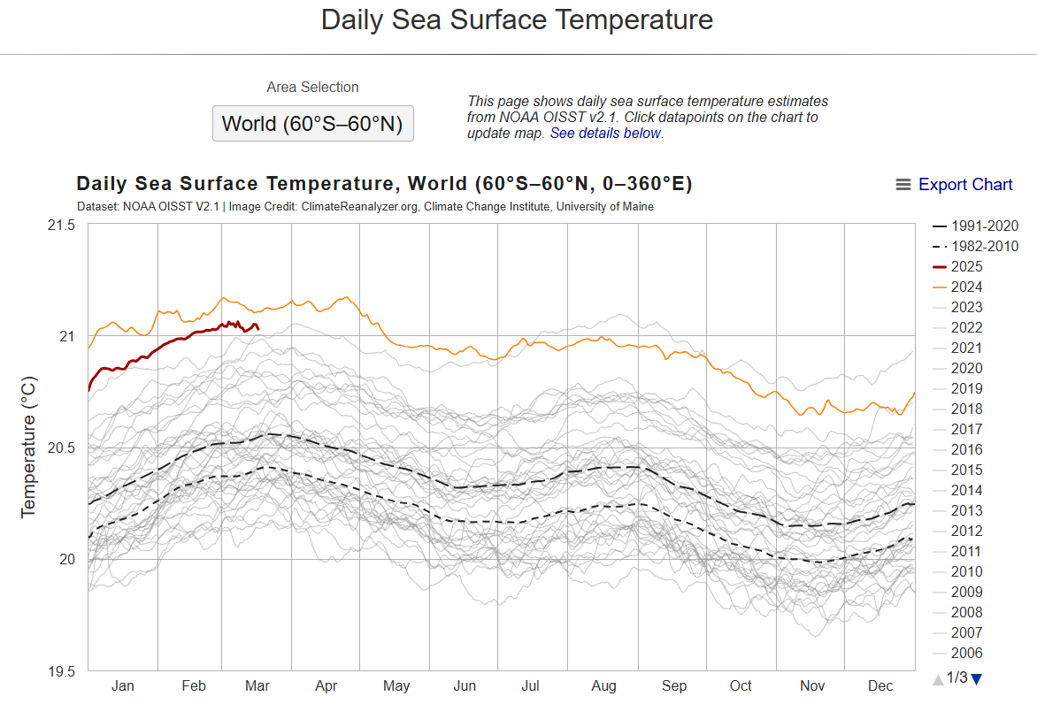
Notes:
This is the graph of the daily sea surface temperature from the climate reanalyser web site. The ocean temperature this year is just insane, as it normally drops ignorantly after an el nino event

Slide 47
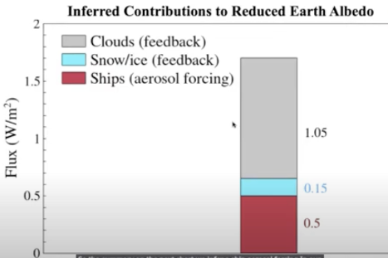
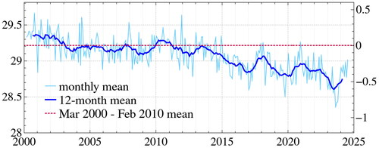
Albedo
Why the sudden increase in the Earth’s temperature in 2023 and 2024?
A sharp decline in the Earth’s planetary albedo by 5% since 2010, which is equivalent to 1.5 W/m-2 global average increase in absorbed solar radiation due to:
Reduced cloud cover
Diminished Artic and Antarctic sea ice
Reduced aerosols from burning marine fuel with > 0.5% sulphur since 2020
Earth’s albedo (reflectivity, in percent), seasonality removed
https://www.tandfonline.com/doi/full/10.1080/00139157.2025.2434494#d1e767
Note: Text and figures from Dr James Hansen’s webinars and articles
Notes:
The Earth’s temperature increased suddenly in 2023 and 2024 and appears to be continuing today. Current climate models do not take this into account so neither do the temperature increase calculations used by my Scenario Explorer. However, the Scenario Explorer does give the users the ability to specify a change in the Earth’s albedo in 2023 and the forecasted temperature will be adjusted accordingly.

Slide 48
How you can help
Review the Web site for accuracy, typos, what’s missing, etc.
Suggestions for making the site “more usable”
Suggestions for making the site more graphically attractive
Develop a couple of “Mitigation and carbon dioxide removal” scenarios
Develop a couple of “Mitigation and SRM” scenarios
Help revise the “Consequences” section – this should be the “go to” section for describing the consequences of following a “mitigation and carbon dioxide removal” pathway
I need help with the “cost section” as the current values are just SWAGs (“scientific wild-assed guesses”) and more costs (e.g., mitigation, GDP loss, etc.) need to be added
I would like to have more detailed data CO2 emissions data from the IPCC AR6 so that I could derive a formula for estimating how much CO2 remains in the atmosphere for a given quantity of CO2 emissions
Notes:
I’m not going to read through this list, but what I’d like to propose that we form a committee to discuss how to improve the web site to further HPAC’s mission.

Slide 49
Thank you! Questions?

Slide 50
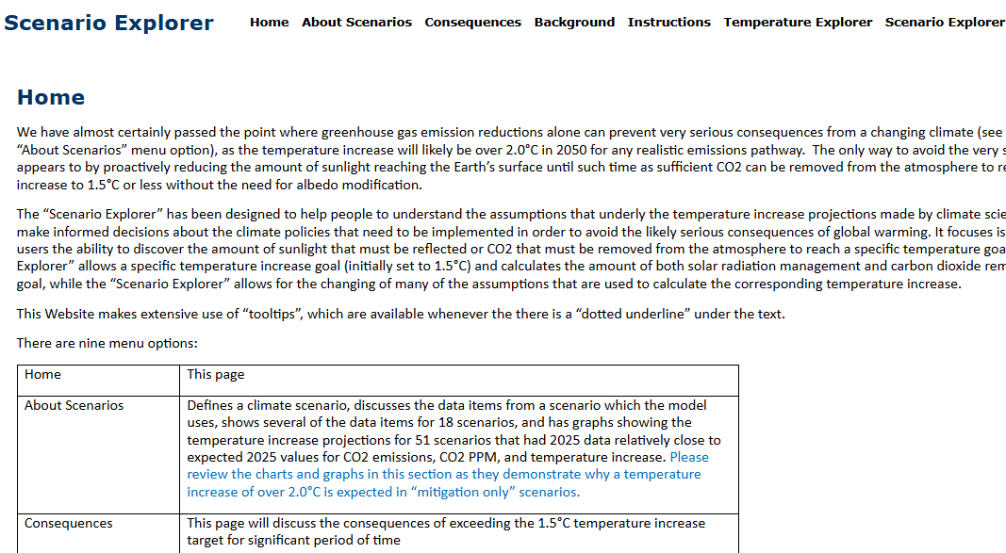
Notes:
Now that you know how the model works, let me give you a quick demo of the web site. Here’s the home page for the Scenario Explorer. As my friends know , I’m good at creating web sites but lousy at making the graphically interesting. Since you are likely most interested in seeing how the model gets used, I’ll start with the Temperature Explorer.

Slide 51
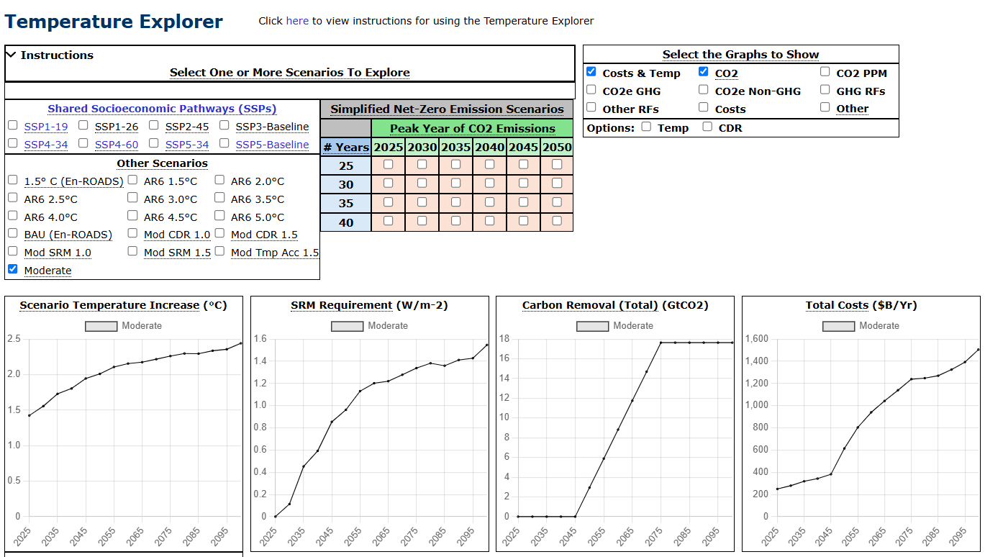
Notes:
The Temperature explorer defaults to showing data for what I refer to as the Moderate scenario, which is basically the HPAC planning scenario. There are two places where instructions can be displayed and I suggest that you look at them the first time you use the web site. The Temperature Explorer also defaults to a calculating the SRM requirement and carbon removal requirement needed to reduce the temperature increase to 1.5 degrees C. More on this a bit later. To compare this scenario to the SSP-5.35 scenario, just click the checkbox to the left of the SSP-5.35 text.

Slide 52
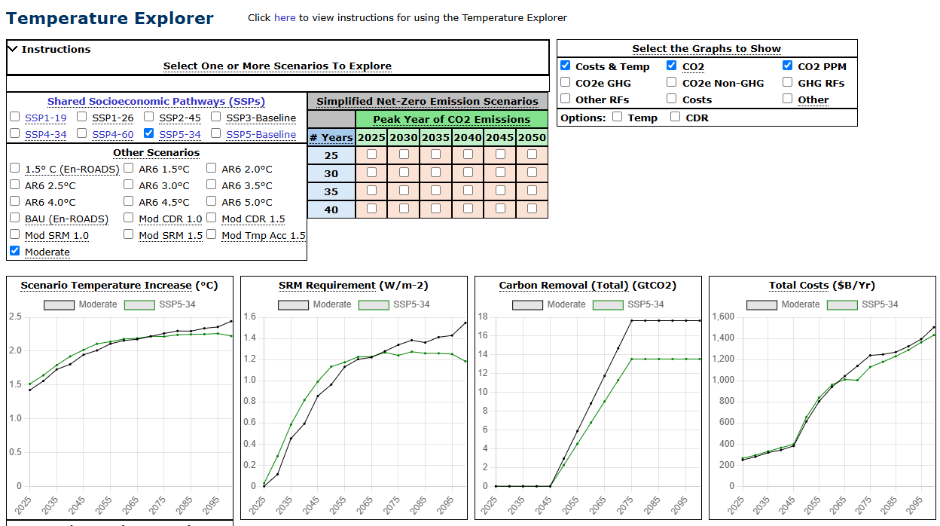
Notes:
Note that the SSP-5.35 has a dashed underline. The underline indicates that a tool tip is available (hover over it). To display some additional graphs (over 30 can be shown), you cam click on a checkbox in the upper right part of the web page (uncheck “Costs..” and check “CO2 PPM; the scroll the page down)

Slide 53
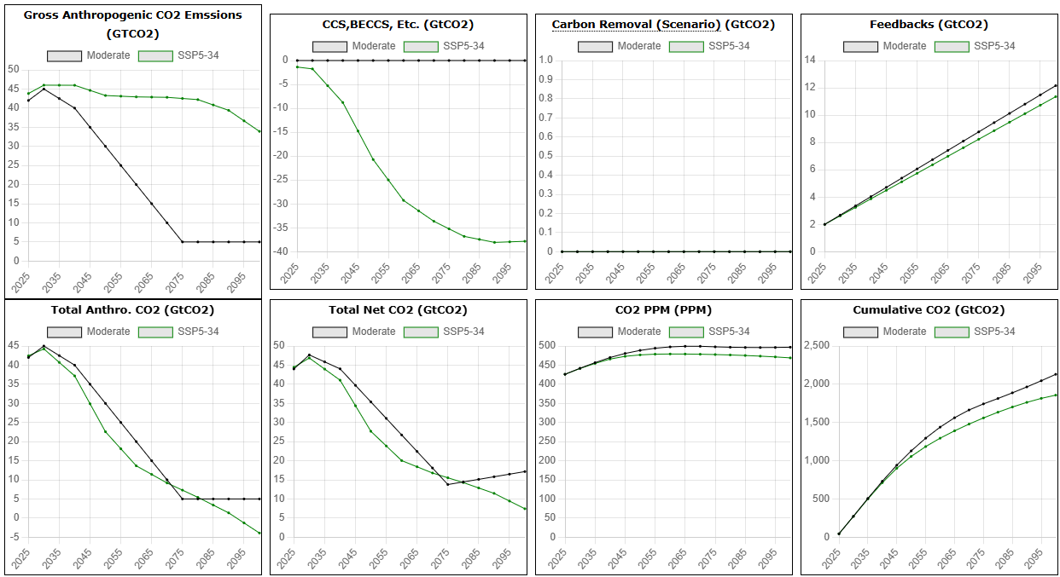
Notes:
Note that these two pathway have similar results but the SSP5-34 includes a lot of carbon removal. Scroll back the top and recheck “Costs.”

Slide 54
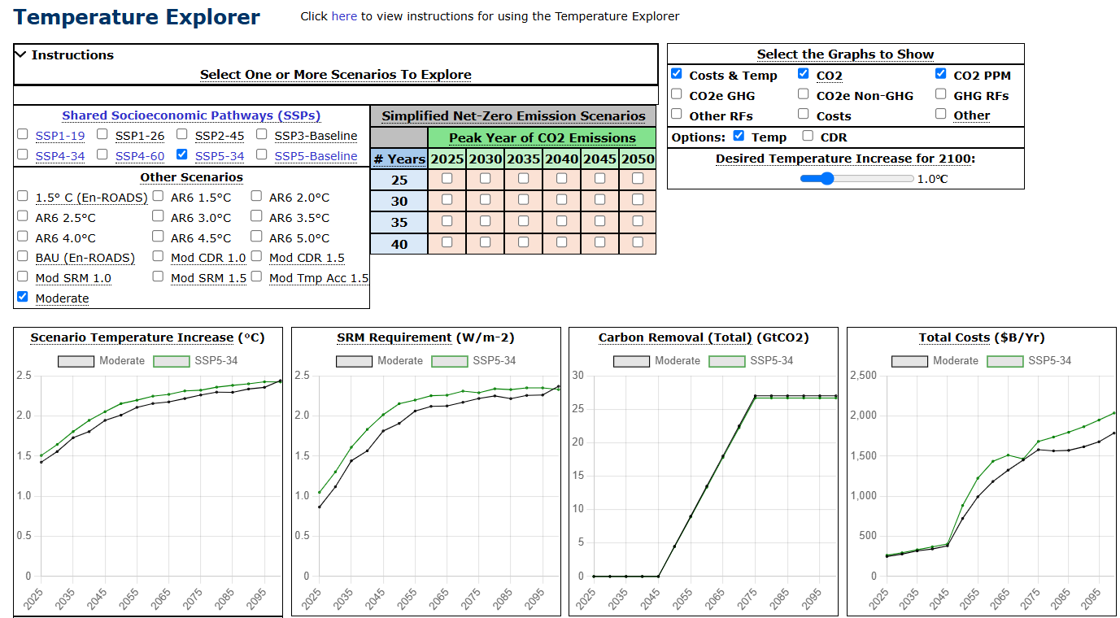
Notes:
As I mentioned earlier, the Temperature Explorer defaults to a calculating the SRM requirement and carbon removal requirement needed to reduce the temperature increase to 1.5 degrees C. To change this assumption, check the “Temp” checkbox and change the “Desired Temperature Increase to 1.0 degree C. Notice the increase in the SRM and CDR requirements.

Slide 55
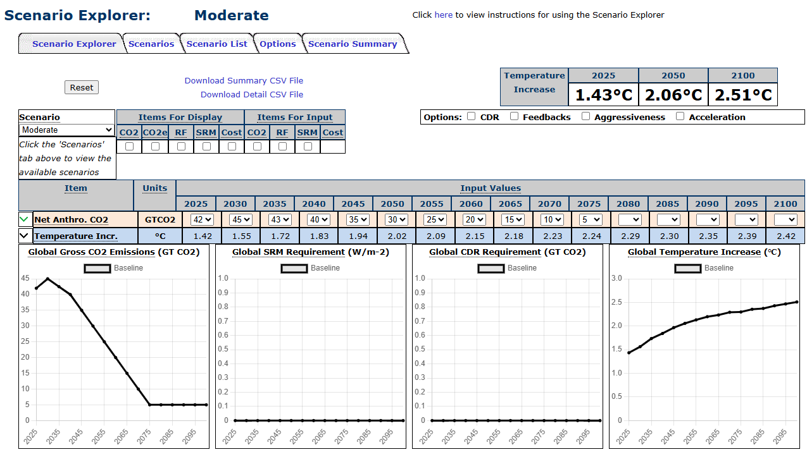
Notes:
Now let’s look at the Scenario Explorer. Again, you can click on a link to display some usage instructions. There’s too much here to explore in a short demo, so let’s look at only a few capabilities. I’ll click the SRM checkbox under “Items for Input”

Slide 56
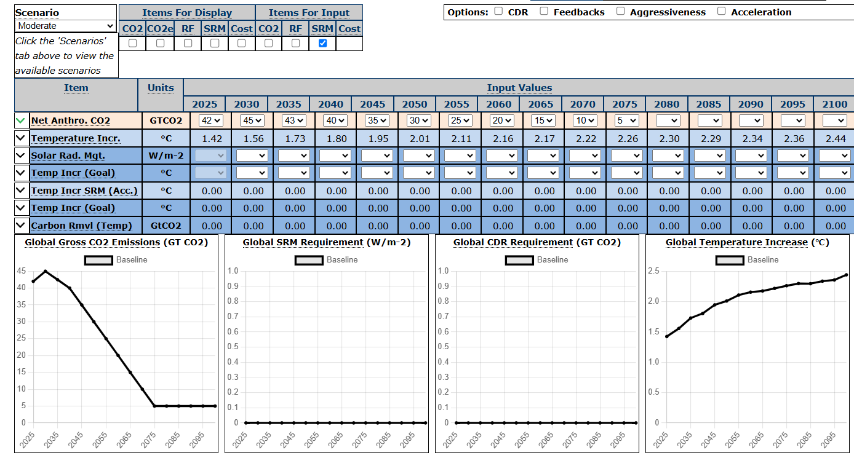
Notes:
Next I’ll select the value 1.9 in the “Temp Incr (Goal) “ drop down list for 2060 and 1.5 for 2100.

Slide 57
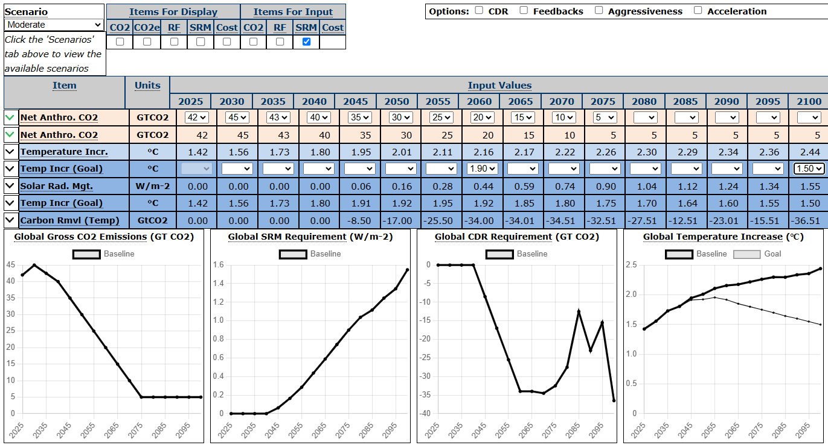
Notes:
I need to adjust my algorithm for calculating the carbon removal requirement, but this gives you a good idea of the amount needed. Click the “Scenarios” tab to see the available scenarios

Slide 58
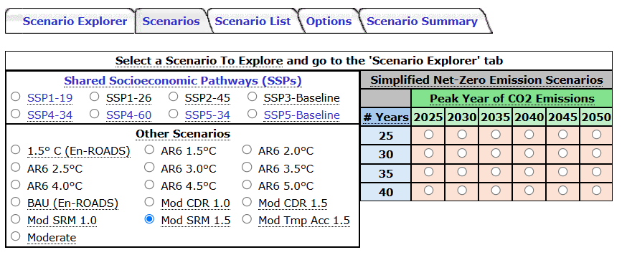
Notes:
Then click the “Mod SRM 1.5” button to display data for that pathway

Slide 59
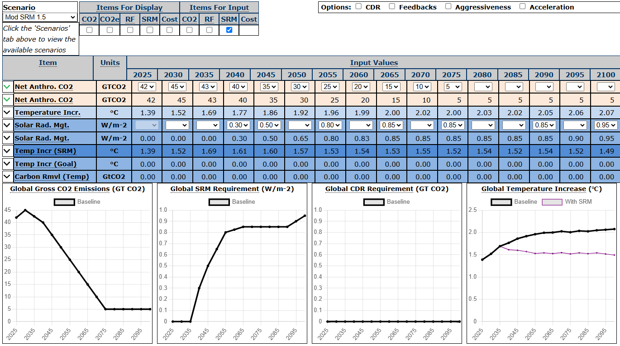
Notes:
This shows an SRM requirement for the HPAC scenario to reach 1.5 degrees in 2100. Click on the “Scenario Summary Tab” to view the model’s calculations

Slide 60
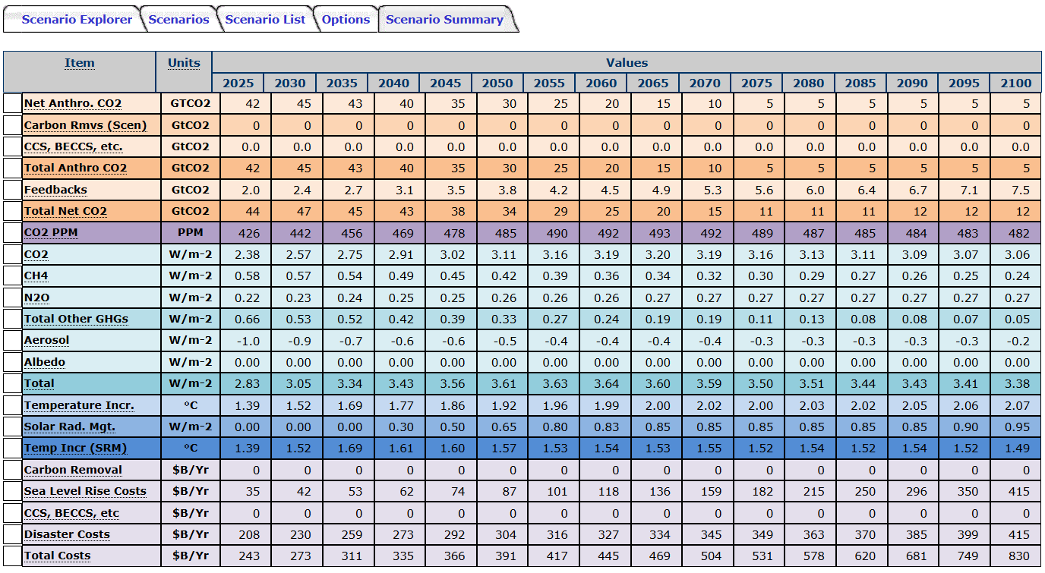
Notes:
Click on The “Scenario List” tab to display a list of the various scenarios

Slide 61
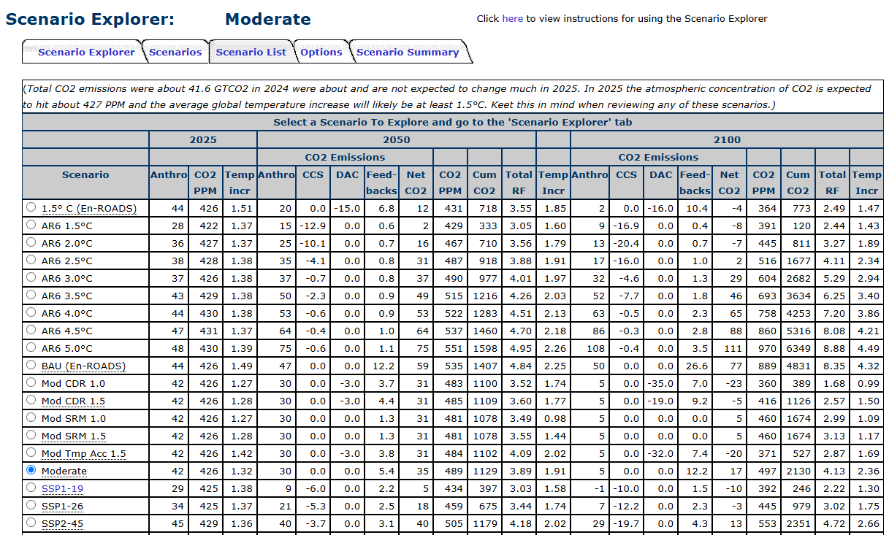
Notes:
The Scenario List tab displays the various scenarios that can be analyzed along with information about the scenarios to help you choose which ones you might want to analyze. Note that almost all realistic scenarios have temperature increases over 1.9 degrees C in 2050, and this is without considering the temperature acceleration that started in 2023.

Slide 62
Notes:
The Scenario Explorer includes several emissions pathways that can be used to analyze the SRM and CDR requirements for meeting various temperature increase targets for the “Moderate” emissions pathway. The number indicates the temperature target and SRM and CDR indicate the technique used to reach the target.

Slide 63
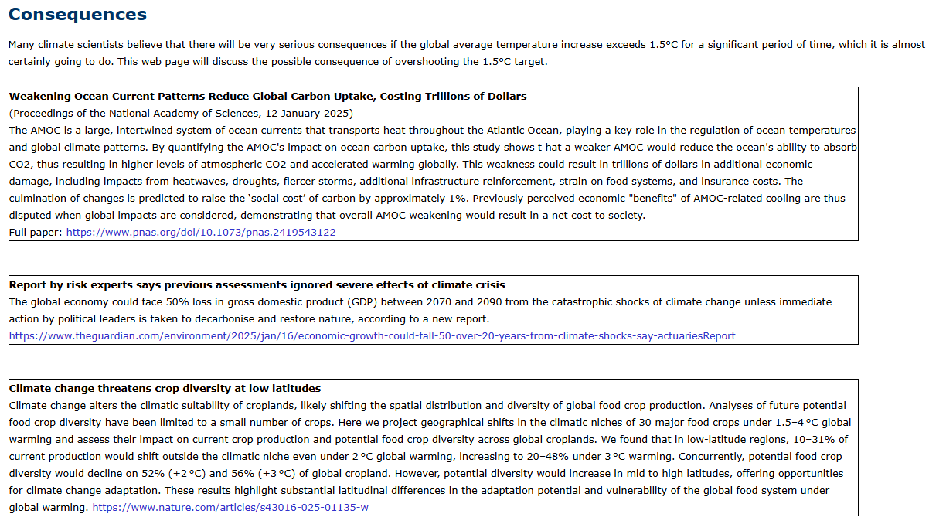

Slide 64
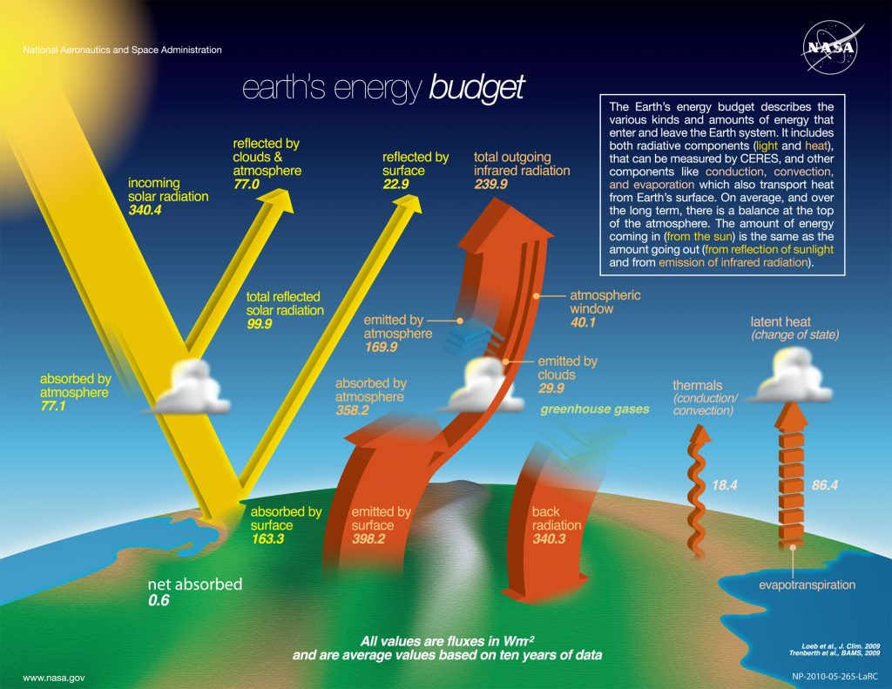
Earth’s Energy Budget
W/m-2 | Energy Budget
340 | Total Incoming
50 | Reflected by clouds
26 | Reflected by the atmosphere (other than aerosols)
W/m-2 | Anthropogenic Radiative Forcing since Pre-Industrial
-0.98 | Reflected by aerosols
3.44 | Trapped by greenhouse gases
-0.14 | Albedo (land use, etc.)
0.59 | Other (ozone, etc.)
2.91 | 2022 Total
https://blogs.cuit.columbia.edu/dmw2158/solar-radiation-the-earths-energy-balance/
Notes:
I wanted to quickly review selected parts of the Earth’s energy budget. We are all concerned about the Earth’s increasing temperature, and this is driven primarily by the increase in atmospheric greenhouse gases. Just think of the Anthropogenic Radiative Forcing as equivalent the sun increasing its energy output by the same amount. So we have essentially increased the Sun’s brightness by about 1%.

